Slide 1

• Aksel Can Sozudogru • Farzana Tasnim • Misha Kutepov • Darren (Qi Fa) Dong •

Slide 2
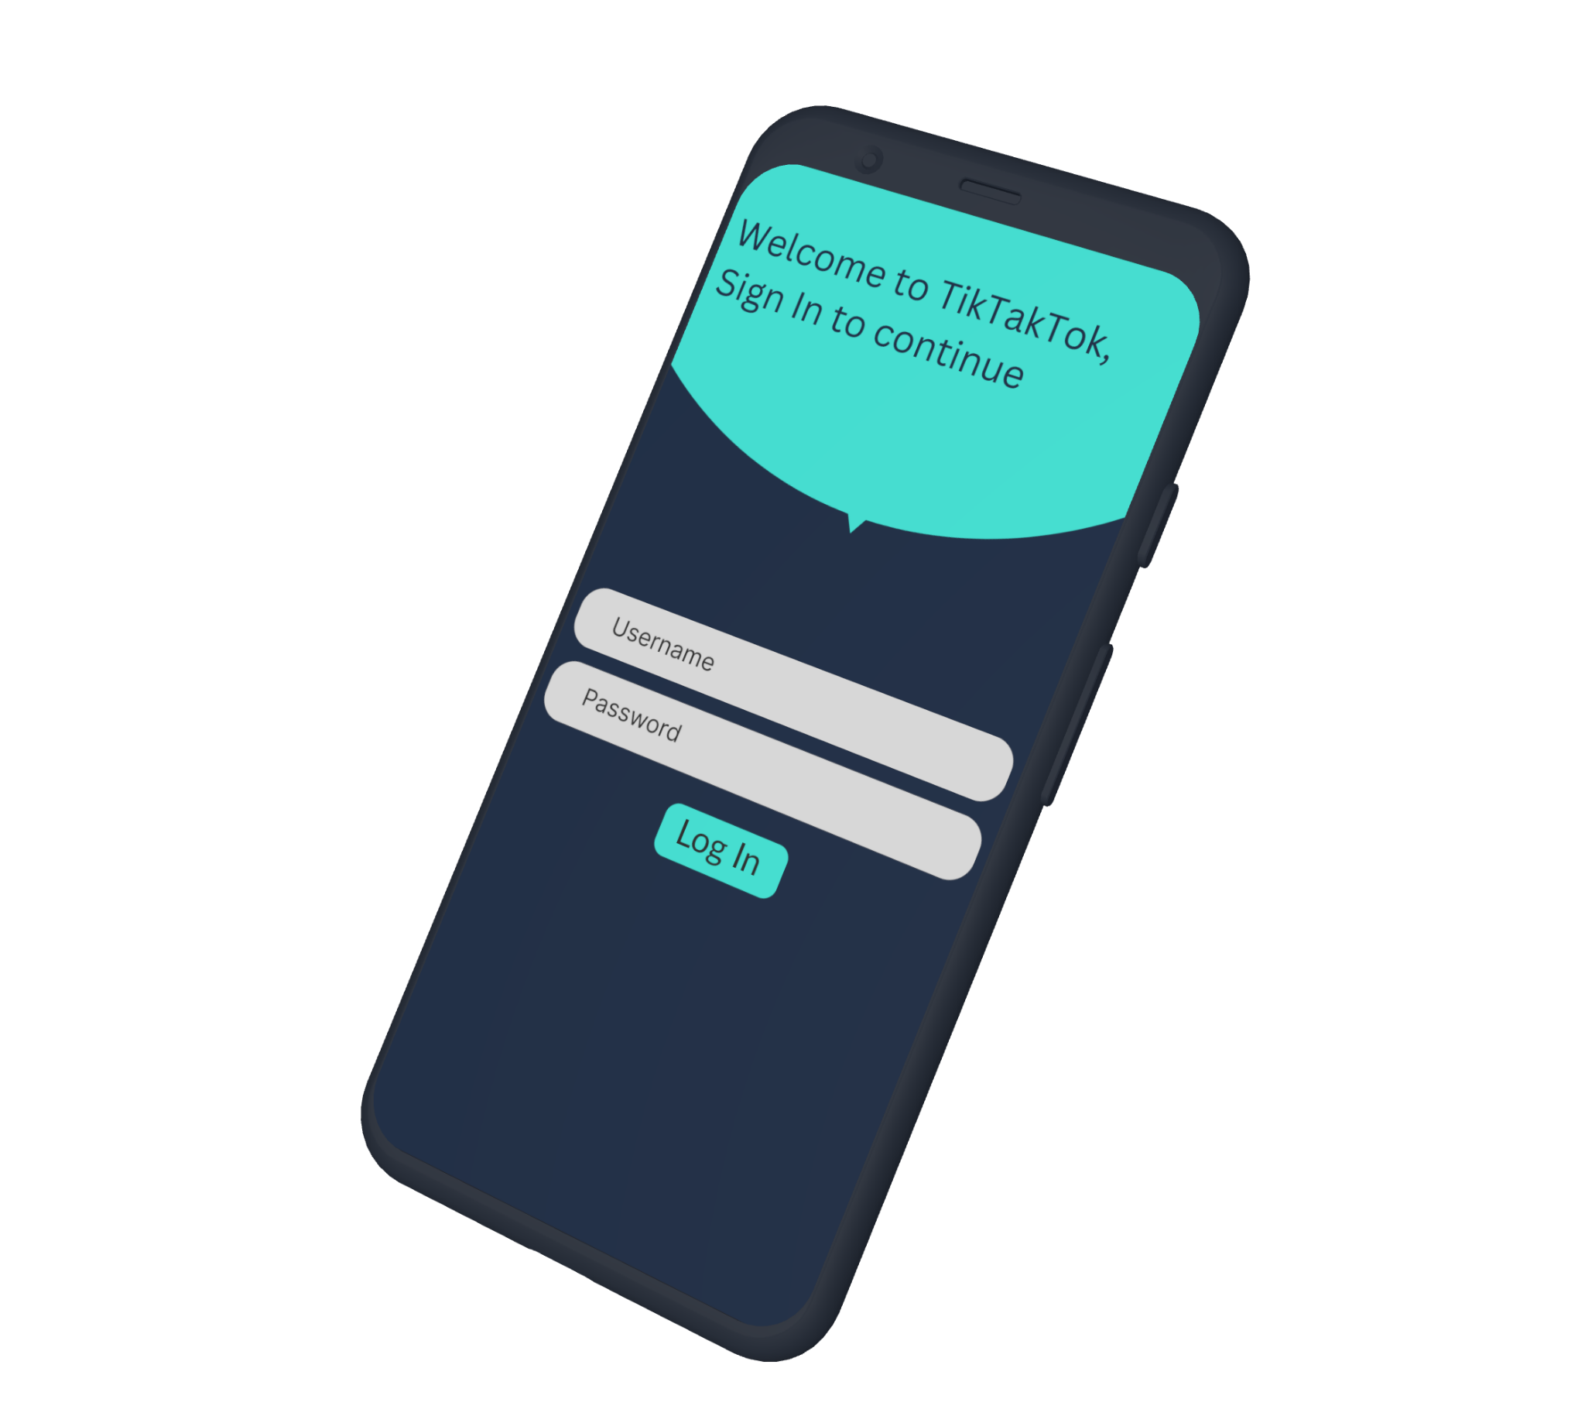
What is
tik tak tok ?
tik tak tok

Slide 3
T • T • T
Tik Tak Tok is a mobile game that is quick, fun, and competitive. The objective is to win as many consecutive tic-tac-toe games. Elements that keeps this gameplay loop fun is that players begin with only 10 seconds and each match won adds +5 additional seconds. Players have to attempt to win as many Tik Tak Tok games in a row before time runs out. Only the Top 3 Players will be displayed on the home Web Page which anyone all over the world can see and compete for the top position.

Slide 4
“GitHub”

Slide 5
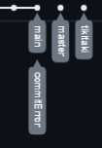
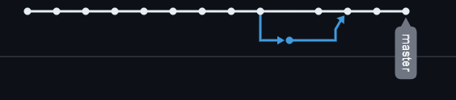
Resource Management
Originally had issues with multiple people committing at the same time. We solved this by only having one person using the repo at a time. Which didn’t really matter as half of the projects relied on a previous sequential part.
So usually only one person would have been working on it at a given time anyways. Except for the modular parts, other person can send files.
Final GitHub Link: https://github.com/DarrenDong2002/tictactoc.git
Network Graphs:
Tracks and displays the traffic from any changes being made.​​
Here there is an issue with conflicting commits.

Slide 6
“Testing”

Slide 7

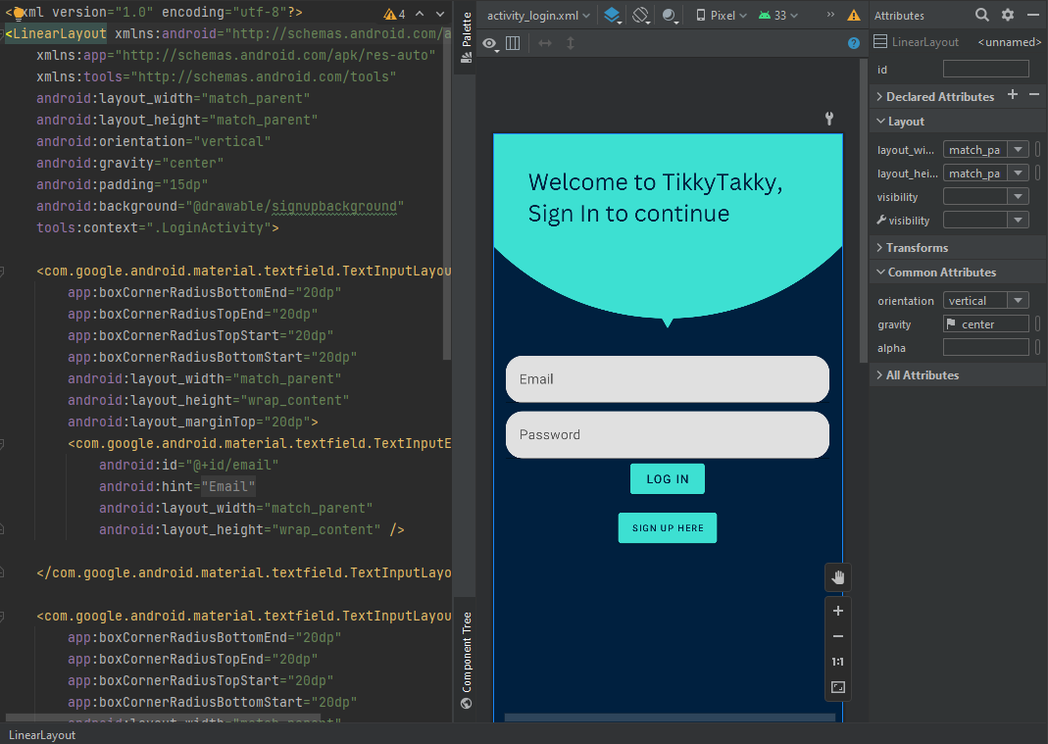
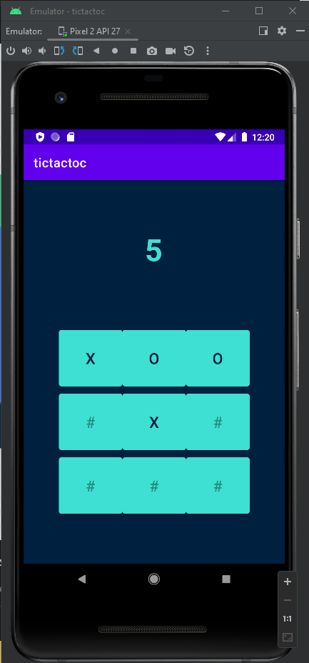
Manual Tests
Much of the testing was done manually through Android Studio using build in tools such as QEMU (Quick Emulator) hypervisor.
Flexible
Quick
Easy to Deploy

Slide 8
“Data Base”

Slide 9

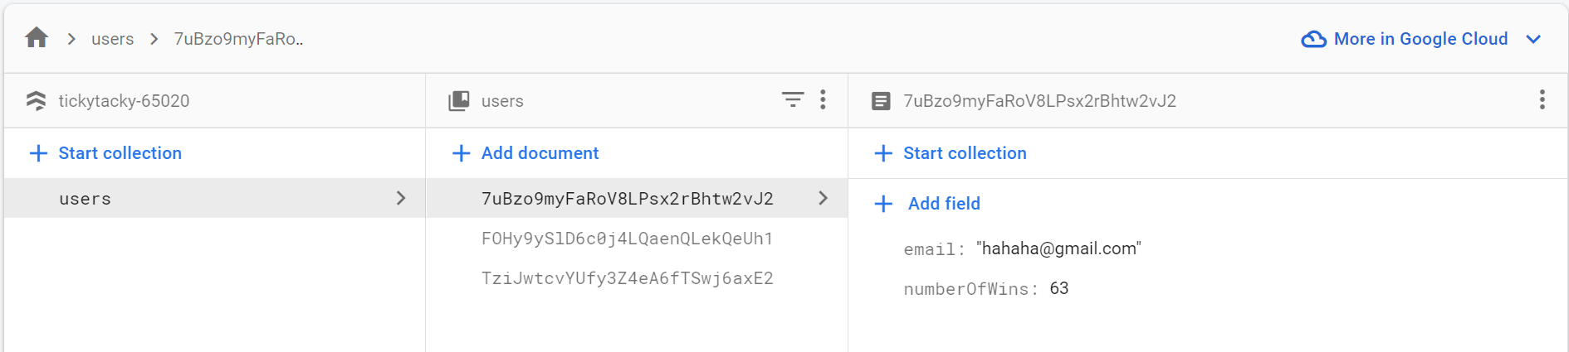
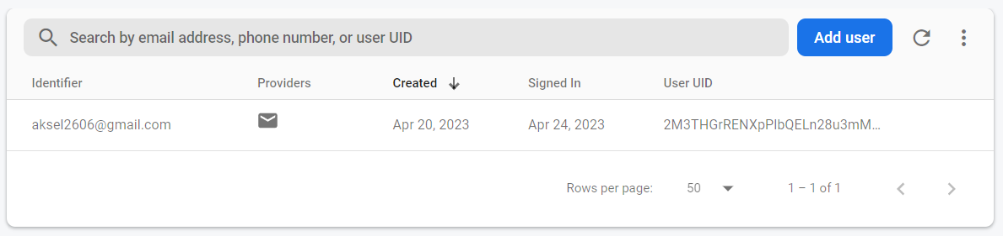
Persistent Data
We opted to use a cloud based data storage system service called Firebase by Google.
Firebase stores our user authentication data along with their highest scores. Which gets published to the leadership web page.

Slide 10
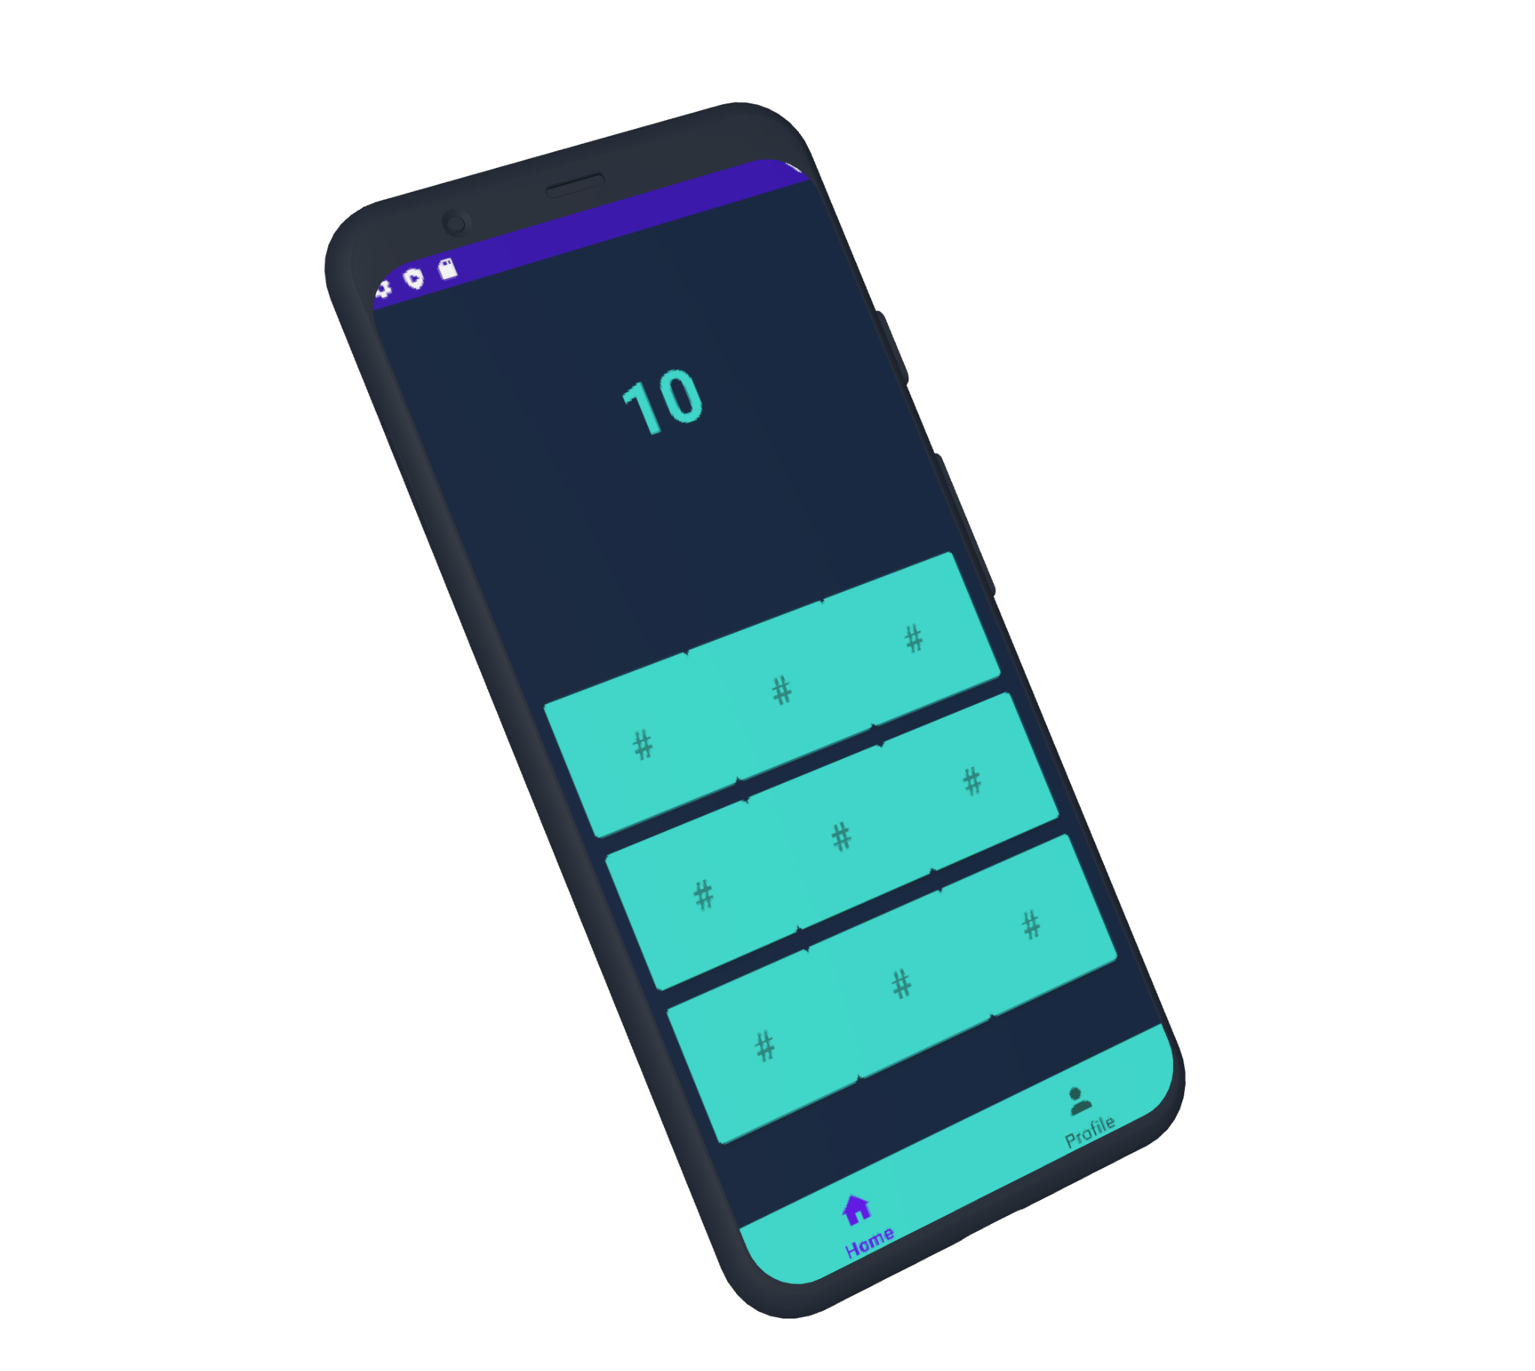
“LIVE DEMO”

Slide 11
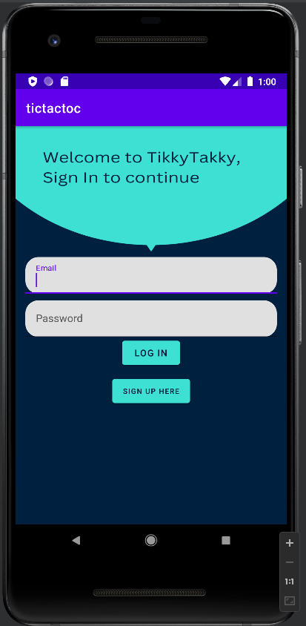
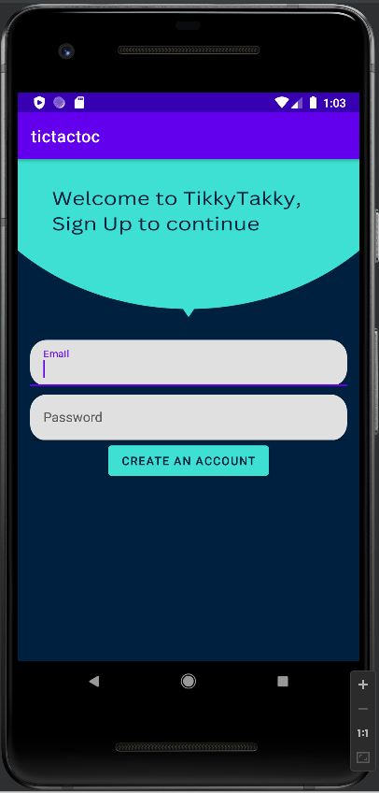
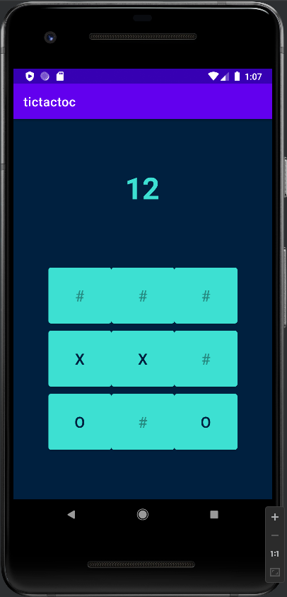
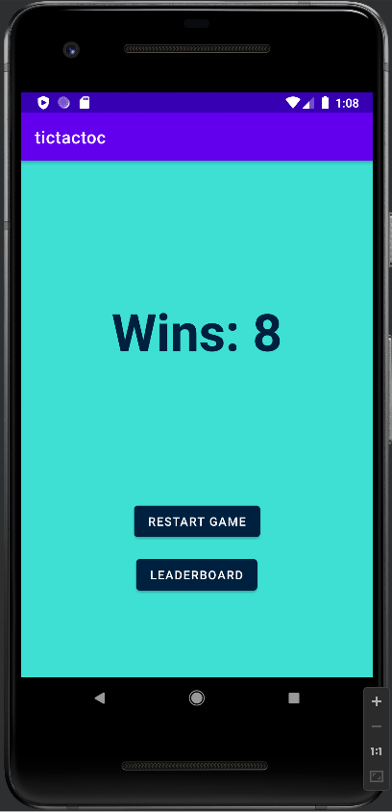
Demo Resources
Firebase: https://console.firebase.google.com/project/tickytacky-65020/overview (see database live update)

Slide 12
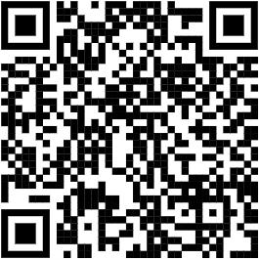
Closing Thoughts…
Future Updates:
Play Store Deployment
Currently in Development
Friend System
More Game Modes
Save Game Feature
Support Multiple Platform
Smart watches, IOS, etc
And Questions

Slide 13
THANK YOU!
THANK YOU!

Slide 14
#0097a7
#3de0d2
#00203f
#00203f

